Slide 1
Why you should pick the coolest
Major

Slide 2

What is WICSE?
Women in Computer Science and Engineering at the University of South Florida
Helping women connect, grow and feel comfortable in the tech industry

Slide 3
What is computer science?

Slide 4
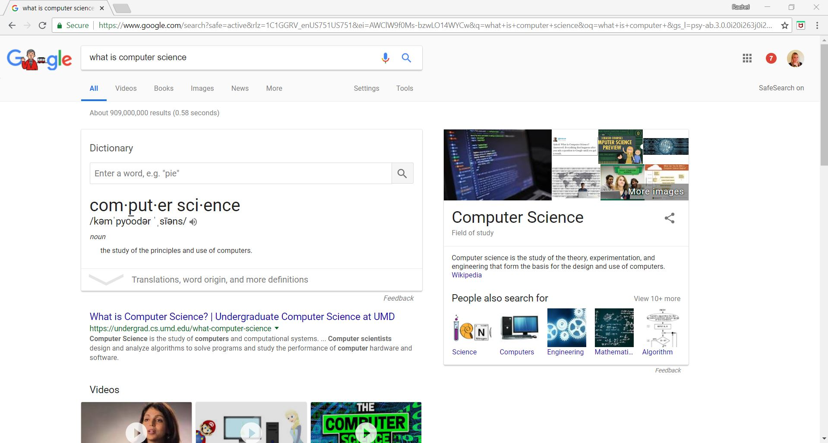

Slide 5
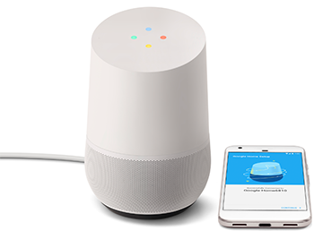
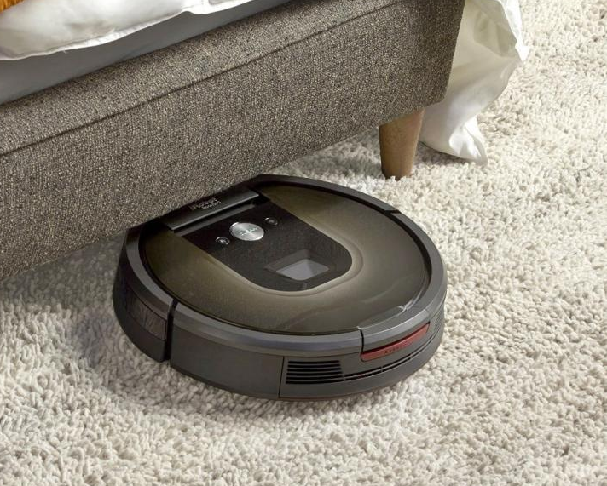

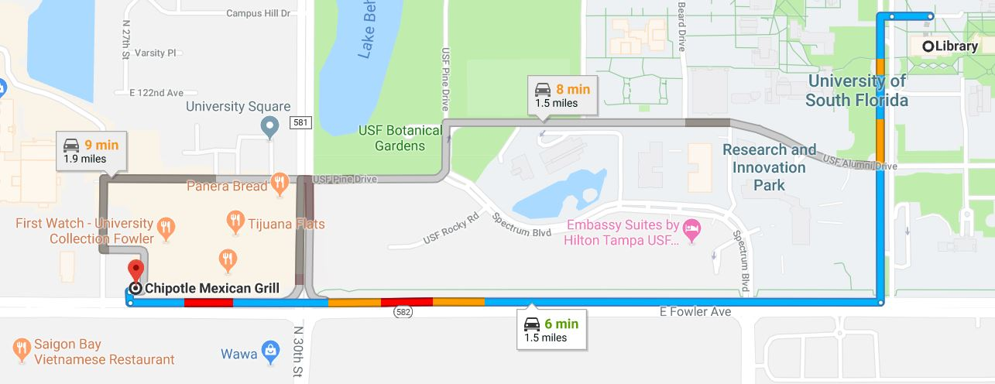
Computer Science is the study of and use of computers that solve the worlds greatest problems

Slide 6
How do we tell computers what to do?

Slide 7
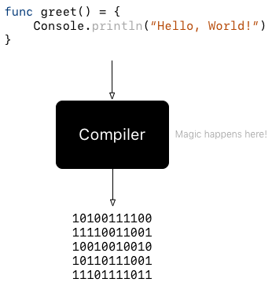
What languages do computers speak?
Machine language consists of 0’s and 1’s
A compiler translates programs
A Programming Language is a concrete and unambiguous set of instructions

Slide 8
Algorithm For PB&J
An algorithm is simply a set of instructions, like a recipe
Design an algorithm for making a peanut butter and jelly sandwich
  Human could say “Put peanut butter on one slice of bread and jelly on the other and put the two slices together
  Computer would be confused by ambiguity: e.g. How do I put the two slices together? How much peanut butter?
  https://tinyurl.com/y8u9bpk4

Slide 9
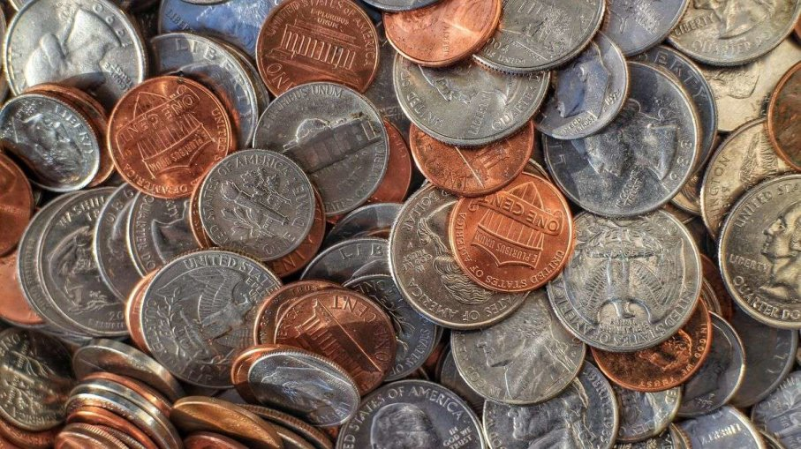
How do we make change using the least amount of coins?
Automatic change machines
How would you tell a human to make 98 cents out of coins?
How would you tell a computer?

Slide 10
What does it take to be a computer scientist?

Slide 11
[ This slide is intentionally left blank ]

